Slide 1



Naan Mudhalvan Niral Thiruvizha Review
BUS TRACKING SYSTEM
Faculty Guide Details: Dr. G. Indirani, Associate Professor, CSE.
Team Leader Name | AU Reg.No | Year | Department | Mobile No
HariHaran S | 822721104020 | IV | CSE | 6369623283
Team members
Pratheeba S | 822721104037 | IV | CSE | 9043122564
Aravind S | 822721104301 | IV | CSE | 9600942509
Jagadeshan M | 822721104021 | IV | CSE | 7373232917

Slide 2
Project Abstract:
The goal of this project “Real-Time Bus Tracking System” is to design and develop a robust system providing real-time bus tracking, efficient schedule management, and accurate commuter information, leading to operational efficiencies and enhance the passenger experience by offering accurate tracking, real-time updates, and timely information for improved planning and safety.
Problem Statement:
How might we implement a GPS-based tracking system for government buses that provides passengers with real-time arrival updates, seat availability, and route information (starting and ending points), ensuring clarity, safety, and convenience at all times? This system should enhance the passenger experience by offering accurate tracking, real-time updates, and timely information for improved planning and safety.
Objective:
To develop a real-time bus tracking system using IoT (Neo-6M GPS + ESP32) and Flask, enabling users to monitor live bus locations, estimate arrival times, and find routes efficiently via a web interface.

Slide 3
Introduction
Problem
Passengers lack real-time bus location/arrival info → delays, overcrowding
1
Solution
IoT + Flask system to track buses, predict arrivals, and optimize routes
2
Key Features
Live GPS tracking, ETA calculation, multi-stop visualization
3

Slide 4

System Architecture
Components
Neo-6M GPS
Hardware
Neo-6M GPS
ESP32
Power Bank
ESP32
Flask Backend
Software
Firebase/SQLite DB
Flask (Python)
Firebase (GPS data)
SQLite (stops/routes)
Frontend Dashboard

Slide 5
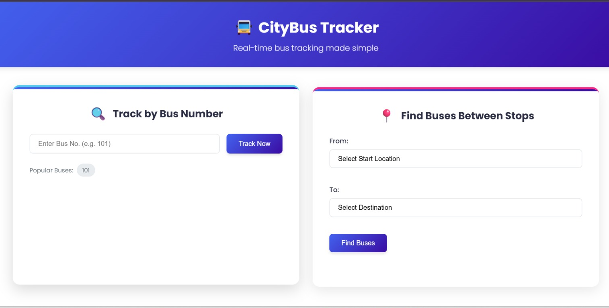
Passenger Modules Overview
Two Ways to Track Your Bus
Core Features:
Real-Time Insights for Every Passenger’s Needs
Module 1 – Track Specific Bus
For passengers who know their bus ID.
"Where’s my bus now, and when will it reach me?"
Module 2 – Find Available Buses
For passengers planning a trip between two stops.
"Which buses can take me from A to B, and which is fastest?"
Left Side
Right Side
Why It Matters:
Bus icon with ID "101"
(representing Module 1)
Two pins on a map with route lines (representing Module 2)
Module 1: Precision tracking for regular commuters.
Module 2: Flexibility for ad-hoc travelers.

Slide 6
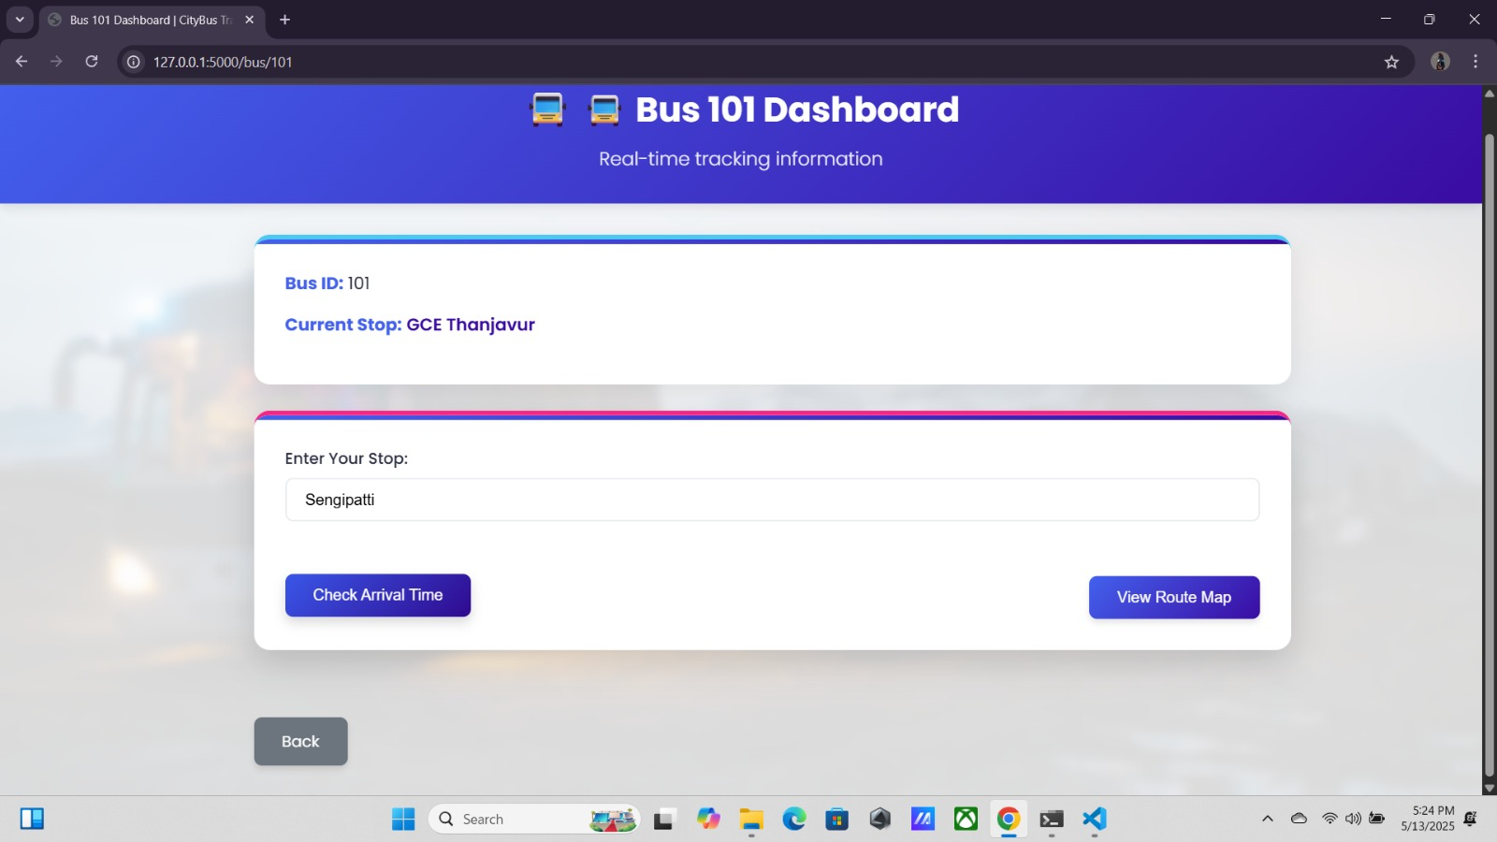
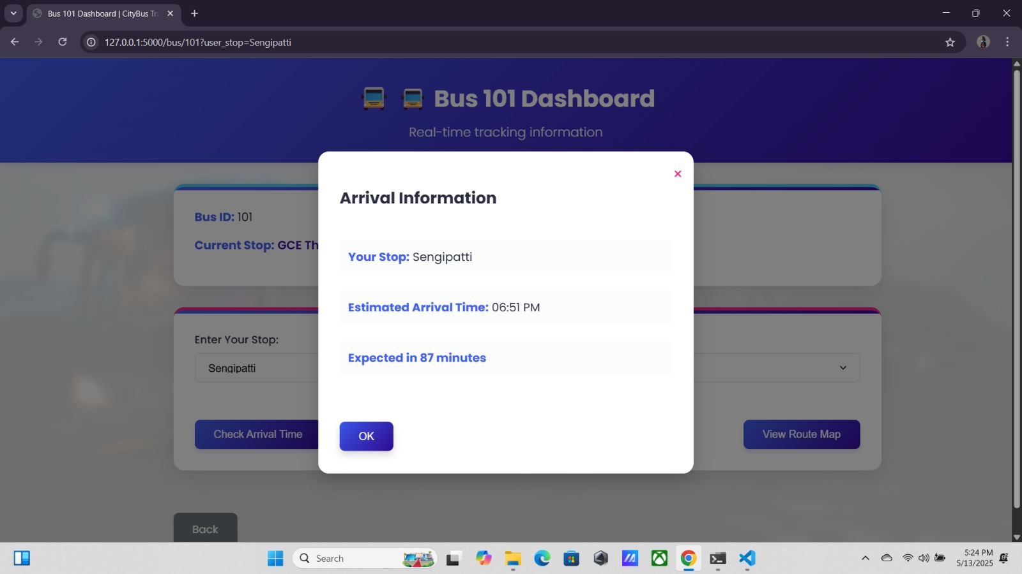
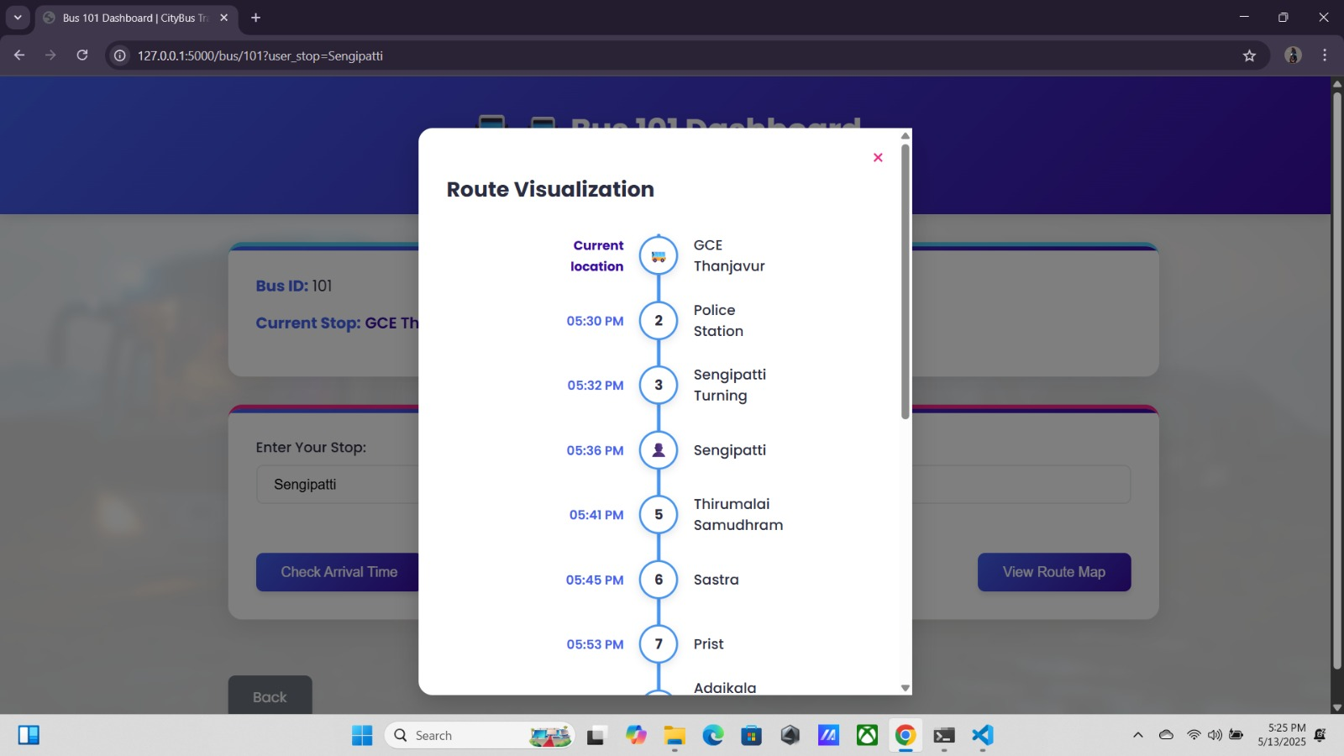
Module 1 – Track Bus by Unique ID
DEMONSTRATE
01
Input
Real-Time Bus Dashboard
User enters a bus ID (e.g., "101").
02
Dashboard Displays:
Bus ID: Confirms the tracked bus.
Current Stop: Live-updated stop name (e.g., "Central Park").
Dropdown: User selects their boarding stop.
Arrival Info:
Clock Time (e.g., "10:15 AM").
Time Left (e.g., "8 minutes").
Visual Aid:
Route Map: Highlighted path from current stop → user’s stop.
Progress Bar: Fills dynamically as the bus moves.
Key Features:
✅ Live Updates: Auto-refreshes every 5 seconds.
✅ User-Centric: Focuses on actionable arrival data.

Slide 7
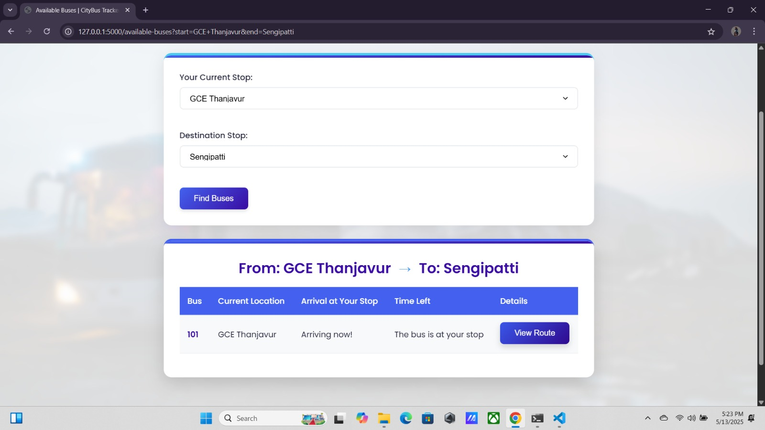
Module 2 – Available Buses on Route
Multi-Bus Tracking for Your Journey
Input
User selects start and destination stops
System Output:
Table of Available Buses with below details
Bus ID
Current Stop
Arrival Time
Time Left
Action
View Details:
Opens a progress visualization:
Stops as checkpoints (blue = current, green = user’s stop,
red = destination).
ETA for each upcoming stop.
Key Features:
✅ Comparative Analysis: Users pick the fastest option.
✅ Transparency: Clear ETAs for all relevant buses.

Slide 8
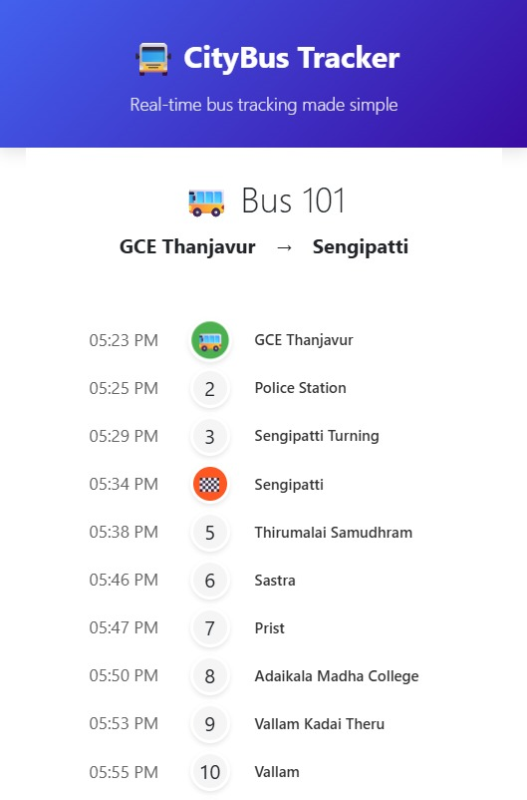
How Location Tracking Works
GPS Data Fetch
Continuously pulls live coordinates (lat, lng, speed) from Firebase every 5 seconds
Distance Calculation
For each known bus stop: Computes the straight-line distance (Haversine formula) between the bus’s GPS location and the stop’s coordinates
Stop Detection
If the calculated distance is <200 meters: The system marks this stop as the bus’s current stop.
Updates the database to reflect the bus’s new position.
Key Features
✅ Threshold-Based: 200m ensures buses are only "arrived" when close enough.
✅ Background Processing: Runs in parallel without disrupting user experience.

Slide 9
Arrival Time Prediction
Stop Position Analysis
Compares the bus’s current stop index vs. the user’s selected stop index in the route sequence.
Decision Tree
User stop behind bus: “Bus already passed.”
User stop = current stop: “Arriving now!”
User stop ahead: Proceeds to ETA calculation.
ETA Calculation
Distance: Sums distances between all stops from the bus’s position → user’s stop.
Time: Divides total distance by the bus’s current speed (or defaults to 30 km/h).
Converts result to minutes and adds to the current time.

Slide 10
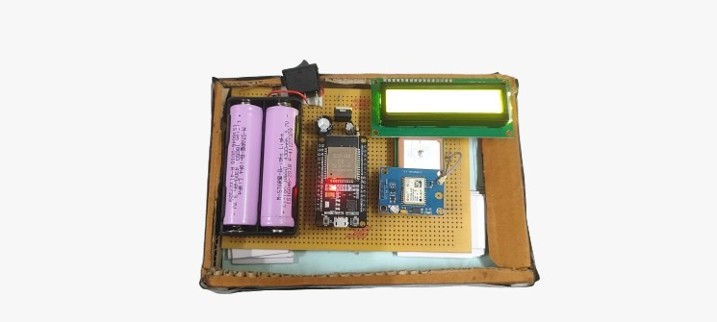
Hardware Integration
Neo-6M GPS
Accuracy: ~2.5m (latitude/longitude + speed)
ESP32
HTTP POST to Flask every 5 sec with GPS data
Power
Two 4300mAh batteries

Slide 11
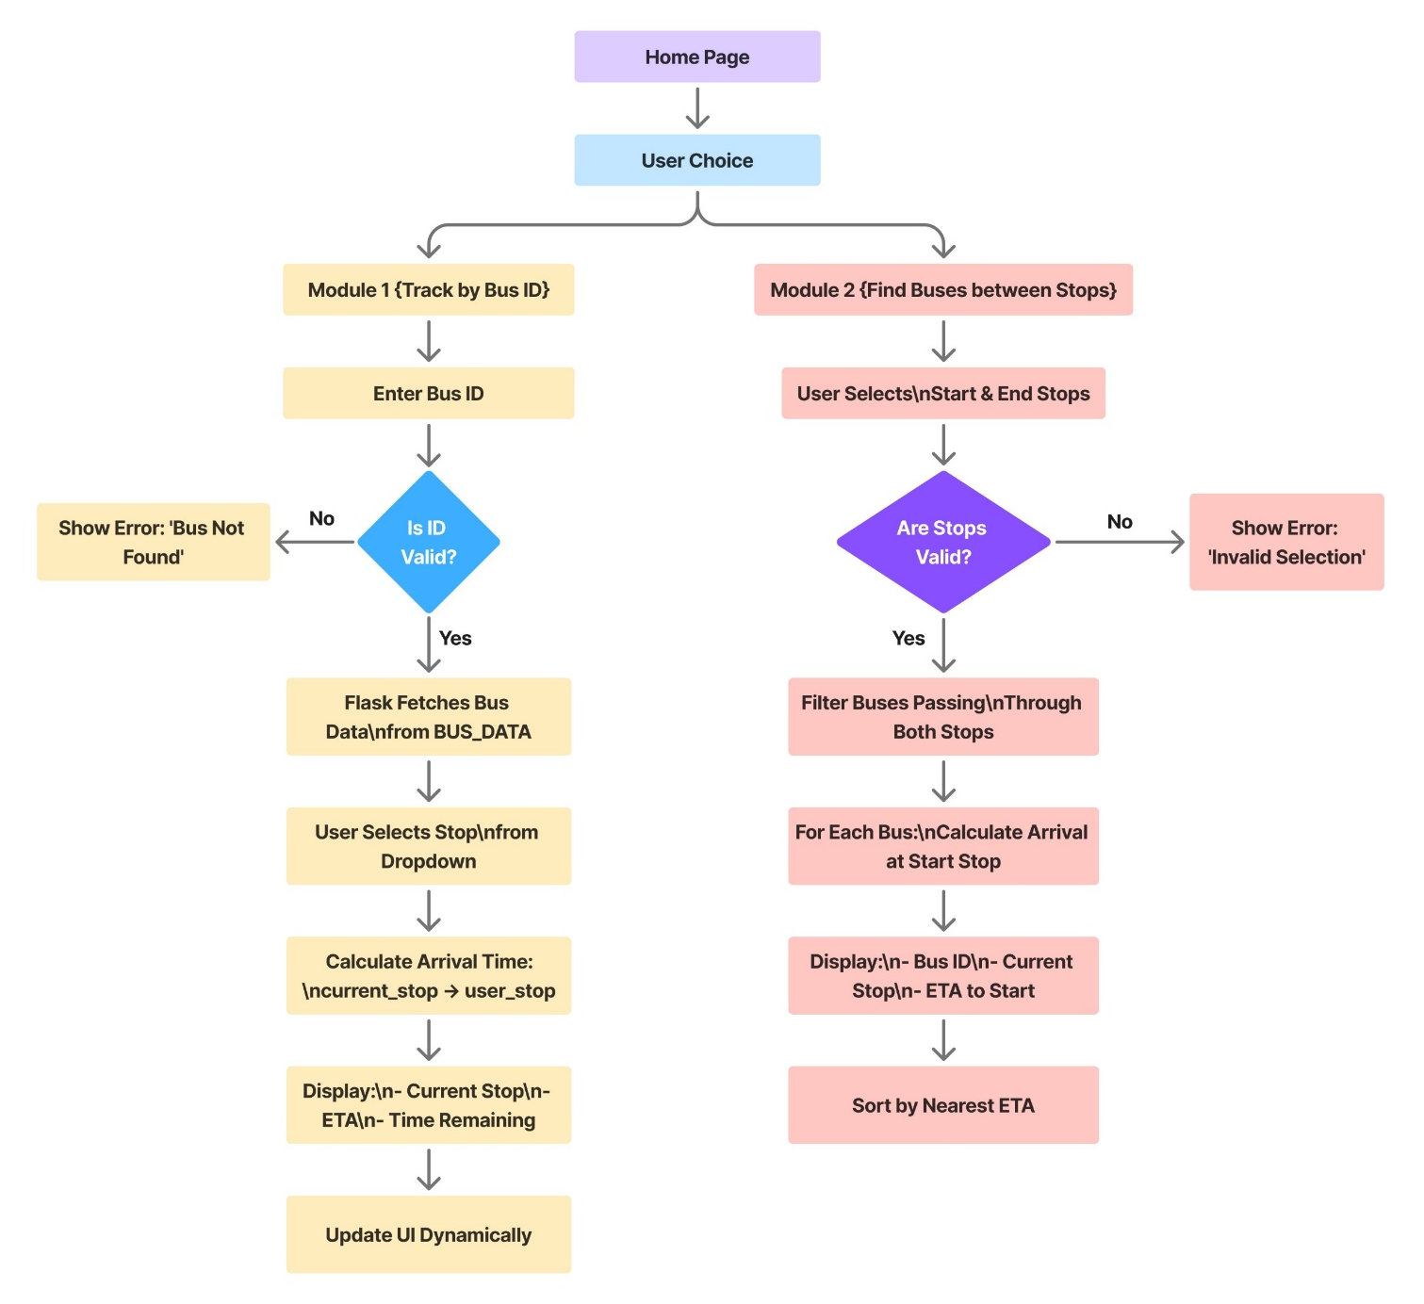
Data Flow Diagram

Slide 12

Working Video of our Bus Tracking System

Slide 13
Passengers
01
Reduced wait times, live tracking.
Easy to use
02
Simple UI for both stop-based and ID-based search
Advantages
Explicitly ties advantages to real-world transportation challenges
Scalable:
03
Customizable for other towns/routes
Low Latency
04
Updates every 5 sec

Slide 14
60%
Hardware (60%): ₹6,000
Hardware
Neo-6M GPS module × 1: ₹2,500
ESP32 microcontroller × 1: ₹1,500
Power bank/batteries × 2: ₹2,000
Budget-Friendly Implementation
Estimated Cost
30%
Software (30%): ₹3,000
✅ Low-Cost Scalability: Add more buses for ~₹6,000 each (hardware-only).
✅ No Recurring Fees: Firebase free tier can be used post Year 1.
Total: ₹10,000 (per bus, one-time setup)
Software
Firebase (1 year, premium tier): ₹1,500
Domain/API costs: ₹1,500
10%
Miscellaneous (10%): ₹1,000
Miscellaneous
Wiring/accessories: ₹500
Contingency: ₹500

Slide 15
THANK YOU!

